Slide 1
PHYS465: Statistical Data Analysis in Physics Week 3: Bayesian Statistics
Dr. Mathew Smith
mat.smith@lancaster.ac.uk
Physics Building; C46

Slide 2
Module Structure
‘model testing’: does our data agree with our model?
Week 11: Fitting a model to data; estimating parameters
Week 12: Hypothesis testing; the likelihood; estimating uncertainties
Week 13: Posterior sampling; Bayesian statistics
Week 14: Clustering and Classification algorithms
Week 15: Machine learning techniques
‘data driven’: what does our data tell us?

Slide 3
Week 13: Previous session
Last week we learnt:
How to design our experiment through the Null hypothesis
This requires us to define a measure of confidence for acceptance
We can measure the probability of our model through the likelihood
This is the probability of our model given the data we obtained
In the case of a Gaussian likelihood we can calculate this through the $χ^{2}$
Best-fit parameter values correspond to where the $χ^{2}$ is minimised
Uncertainties on our parameters can be calculated from this PDF
$$-2lnL(θ|x)=χ^{2}+2\overset{N}{\underset{i=1}{∑}}lnσ_{i}+Nln(2π)$$

Slide 4
Week 13: Learning aims
Today we will introduce
Bayes theorem and how it relates to parameter estimation
The posterior, likelihood, prior and evidence
The difference between Bayesian v Frequentist
Sampling methods:
Markov Chain Monte Carlo (MCMC)
Practical tips for smooth sampling
Estimating distributions from MCMC
Practical examples on Friday!

Slide 5
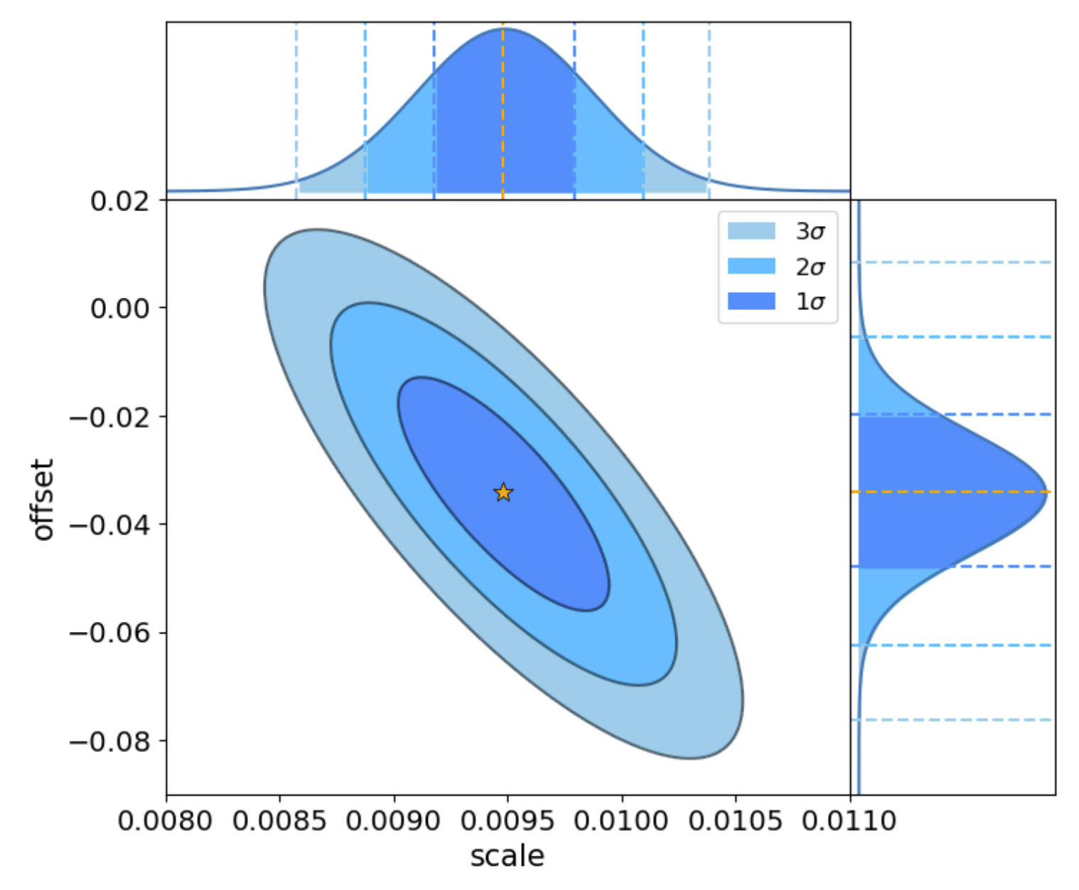
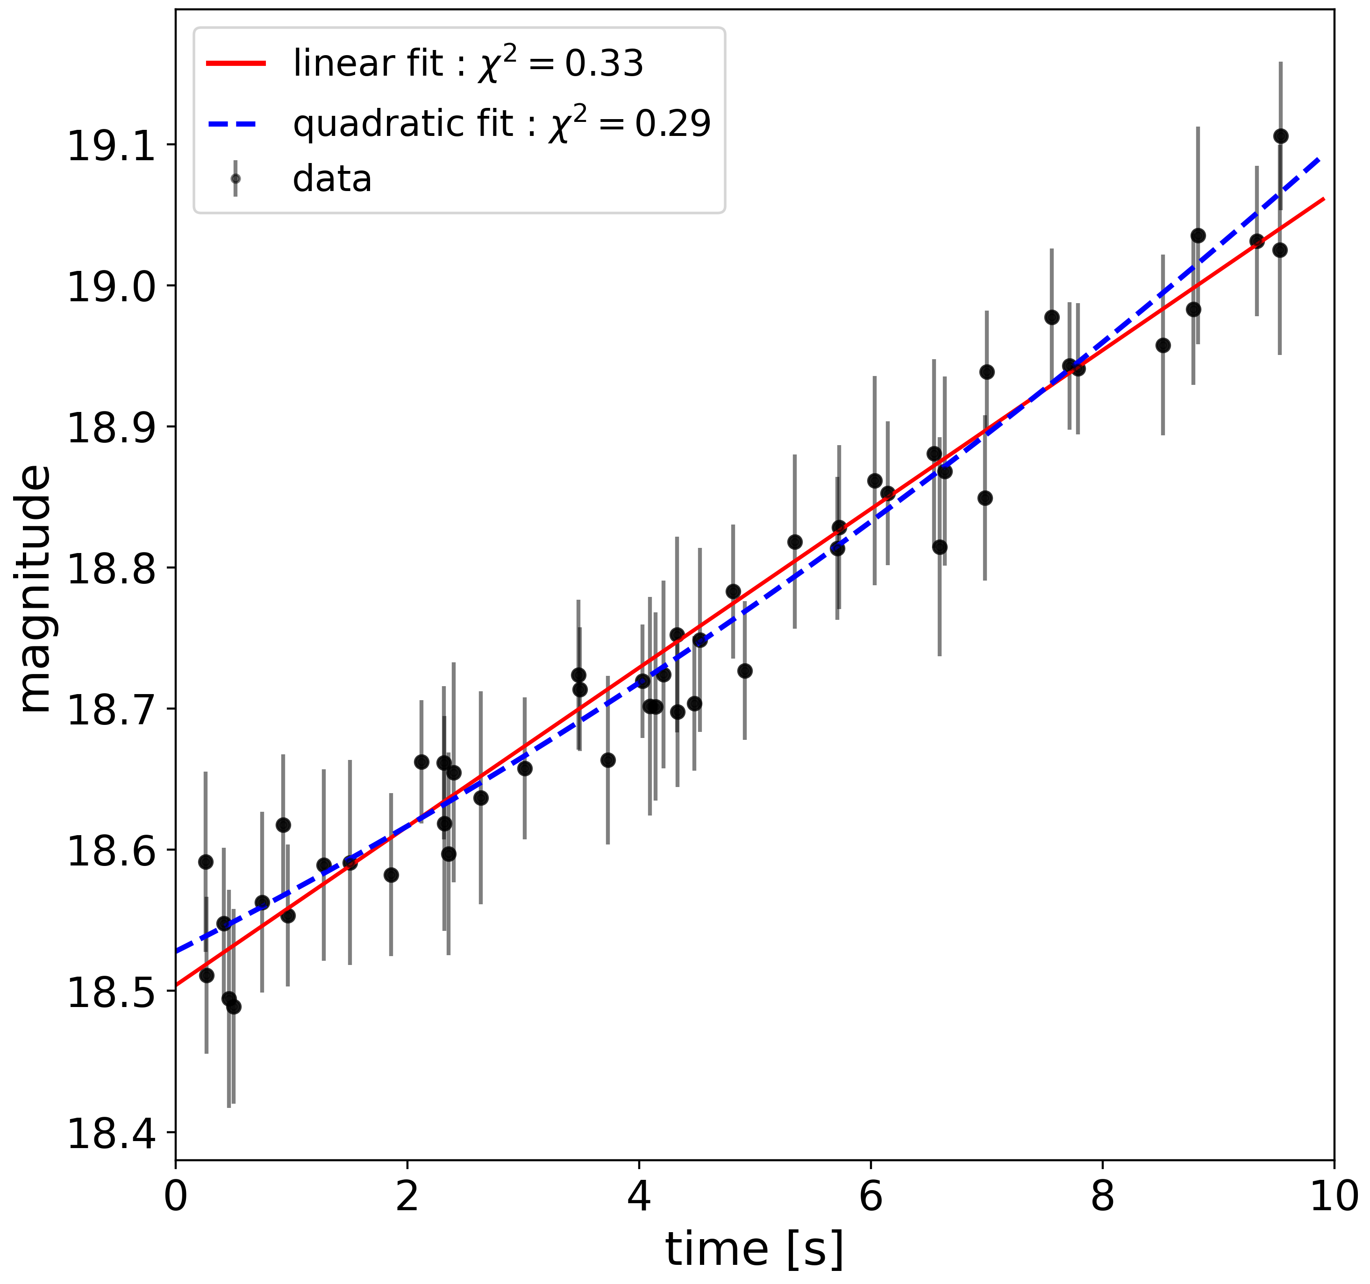
Recall: statistical inference
1. Given two models $M_{1},M_{2}$ how do we know which one is best?
2. Given a parameter $P$ what is the probability that the true value lies in a given range?

Slide 6
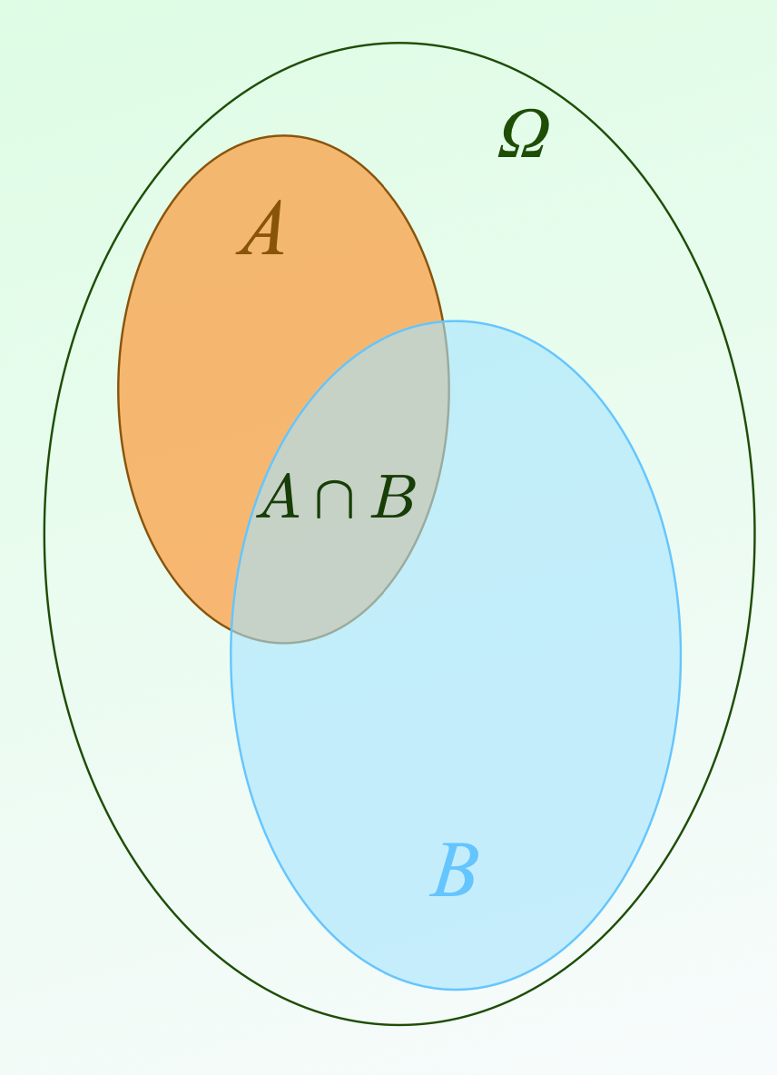
Recall: Conditional Probabilities
$$P(A|B)=\frac{P(A∩B)}{P(B)}$$
$$Ω$$
$$\text{A}$$
The probability of $A$ given $B$ (an event or condition)
$$\text{A}∩\text{B}$$
when $θ$ is a model, or parameter
$P(A|θ)$ is called the likelihood: $L(θ|A)$
$$\text{B}$$
“the likelihood of obtaining the data ‘A’ given the model”

Slide 7
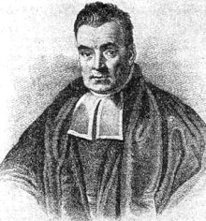
Bayes Theorem
Under the assumption that:
$$Ω$$
$$P(A∩B)=P(B∩A)$$
$$\text{A}$$
$$P(A|B)P(B)=P(B|A)P(A)$$
Thomas Bayes 1701-1761
$$\text{A}∩\text{B}$$
$$P(A|B)=\frac{P(B|A)P(A)}{P(B)}$$
$$\text{B}$$
The probability of $A$ given $B$ (an event or condition)
Notes:
1760s

Slide 8
Bayes Theorem
for a specific model $θ$
$$Ω$$
$$\text{A}$$
And some data $D$
Thomas Bayes 1701-1761
$$\text{A}∩\text{B}$$
$$P(θ|D)=\frac{P(D|θ)P(θ)}{P(D)}$$
$$\text{B}$$
The probability of the model given our measurements

Slide 9
Bayes Theorem
$$P(θ|D)=\frac{P(D|θ)P(θ)}{P(D)}$$
The probability of the model given our measurements
Thomas Bayes 1701-1761
$$P(θ|D)$$
The posterior
The probability of the model ($θ$) being true given the data
The likelihood
Given the model ($θ$) what is the likelihood of getting the data
$$P(D|θ)$$
$$P(θ)$$
The prior
The probability of the model ($θ$) being true
$$P(D)$$
The evidence
The probability of getting the data given all model possibilities

Slide 10
Likelihoods
Given a set of measurements $x=(x_{1},x_{2},...)$
$$L(θ|x)=\overset{N}{\underset{i=0}{∏}}P(x_{i}|θ)$$
the likelihood:
Best-fit value:
The value that maximises $L$
Plausible values:
Determined by the width of $L$
Uncertainty:
For a Gaussian distribution $1σ$

Slide 11
Log Likelihoods: the Gaussian case
$$p(x_{i})=\frac{1}{\sqrt{2π}σ_{i}}exp\left(-\frac{(x_{i}-μ_{i}(θ))^{2}}{2σ_{i}^{2}}\right)$$
Given a set of measurements $x=(x_{1},x_{2},...)$
$$L(θ|x)=p(x_{1}|θ)*p(x_{2}|θ)*...$$
$$L(θ|x)=e^{-χ^{2}/2}*\overset{N}{\underset{i=1}{∏}}\frac{1}{σ_{i}}×(2π)^{(-N/2)}$$
$$-2lnL(θ|x)=χ^{2}+2\overset{N}{\underset{i=1}{∑}}lnσ_{i}+Nln(2π)$$
Maximising $L(θ|x)$ is equivalent to minimising $χ^{2}$

Slide 12
Log Likelihoods: the Gaussian case
$$p(x_{i})=\frac{1}{\sqrt{2π}σ_{i}}exp\left(-\frac{(x_{i}-μ_{i}(θ))^{2}}{2σ_{i}^{2}}\right)$$
Given a set of measurements $x=(x_{1},x_{2},...)$
$$L(θ|x)=p(x_{1}|θ)*p(x_{2}|θ)*...$$
$$-2lnL(θ|x)=χ^{2}+2\overset{N}{\underset{i=1}{∑}}lnσ_{i}+Nln(2π)$$
Penalty terms:
Only needed for
normalisation
Maximising $L(θ|x)$ is equivalent to minimising $χ^{2}$

Slide 13
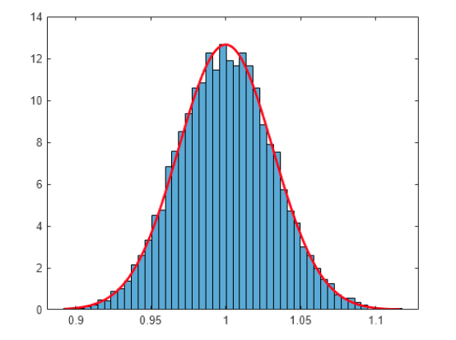
An aside: Maximum Likelihood Estimators
Used across Machine Learning
The value of the model parameters that maximises the probability
Probability of the data given the model
$$p_{\text{max}}=\text{max}(p_{\text{model}}(x_{1},x_{2},...,x_{N}))$$
Probability of the model given the data
$$L_{\text{max}}=\text{max}(L(θ|x))$$
Many available algorithms

Slide 14
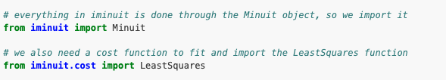
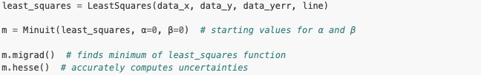
An aside: Maximum Likelihood Estimators
Many available algorithms
MINUIT
Used a lot in particle physics
Comparable to curve_fit but faster

Slide 15
The Prior
Our decision adapts as new data comes in
Our previous experience
An opportunity to state previous information relevant to our experiment
*”no assumption” is still an assumption
a feedback loop: past results inform new results
the probability of the Null Hypothesis without data
Probability
Flat prior
Gaussian prior
Parameter value

Slide 16

Bayesian v Frequentist
Bayesian: Models are not ruled out: they are assigned a probability
Probability is a degree of belief: it can change with new information
The data is a fixed outcome
Frequentist: Attempt to rule out models given the data
Probabilities are assigned to the data not the model
Different approaches depending on the experiment
Frequentist : single correct answer P(heads)=0 or 1
Bayesian: depends on beliefs (prior results)
What will the weather be like tomorrow?
* considered difficult to calculate given multiple parameters
Notes:
Data is drawn from repeatable random sampling: there is a frequency to it
What will the weather be tomorrow?

Slide 17
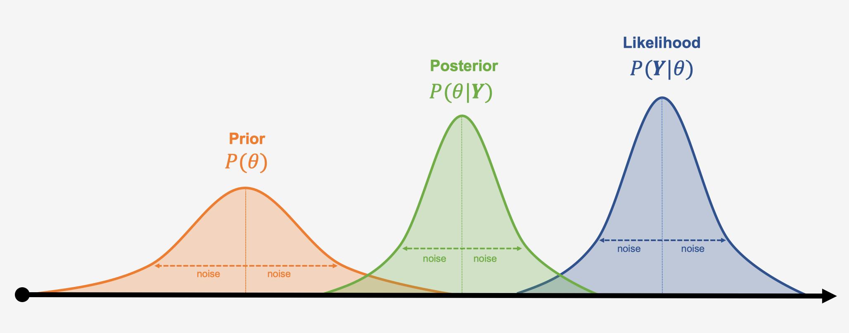
The Posterior
Combines previous results with new data
$$\text{posterior}=\text{likelihood}×\text{prior}$$

Slide 18
The Posterior
Combines previous results with new data
$$\text{posterior}=\text{likelihood}×\text{prior}$$
A worked example:
A person’s DNA matches that of a sample found at a crime scene.
The chances of a DNA match are 1 in 2 million
What is the probability that the DNA comes from someone else?
Frequentist: 1 in 2 million

Slide 19
The Posterior
Combines previous results with new data
$$\text{posterior}=\text{likelihood}×\text{prior}$$
A worked example:
What is the probability that the DNA comes from someone else?
Bayesian: Question the model not the data
testing positive is a given measurement ;
>how much more likely does this make her guilty than before?
1 in 2 million is “the likelihood that a random person’s DNA will match”

Slide 20
The Posterior
Combines previous results with new data
$$\text{posterior}=\text{likelihood}×\text{prior}$$
A worked example:
What is the probability that the DNA comes from someone else?
$$\text{likelihood}=\frac{\text{probability of observation if guilty}}{\text{probability of observation if innocent}}=2\text{million}$$
$$\text{prior}=\text{the woman is equally likely to be guilty as anyone else}$$
=> Bayesian: How big is the wider population?

Slide 21
The Posterior
Combines previous results with new data
$$\text{posterior}=\text{likelihood}×\text{prior}$$
A worked example:
What is the probability that the DNA comes from someone else?
$$\text{prior}=\frac{1}{300,000}$$
if population == 300,000
$$\text{posterior}=\text{likelihood}×\text{prior}$$
= $1\text{in}7$
$$\text{p(guilty|DNA)}=87\%$$

Slide 22
Analytic Solution
“conjugate prior”
the likelihood and prior have the same functional form
$$\text{likelihood}∝\text{gaussian}$$
if
The prior is just extra data
$$\text{prior}∝\text{gaussian}$$
$$\text{posterior}∝\text{gaussian}$$
Rule of thumb:
$n_{data}$ large | small $σ$ : posterior dominated by likelihood
$n_{data}$ small | large $σ$ : posterior dominated by prior

Slide 23
The Evidence
The probability of getting the data given all model possibilities
A single value : no impact on the shape of posterior
=> not required to compare parameter values
but also:
“the probability that the model is a correct given the data”
=> model selection in Bayesian statistics
* difficult to calculate in the presence of noise

Slide 24
Credible Intervals
Bayesian: Given the observed data,
the interval within which a parameter value falls with given probability:
$$\overset{̂}{p}-δp≤P_{0}≤\overset{̂}{p}+δp$$
XX% probability that the true value of P lies between $\overset{̂}{p}-δp$ and $\overset{̂}{p}+δp$
Frequentist: We measure confidence intervals from the data:
there’s a XX% chance that the true mean falls within this range

Slide 25
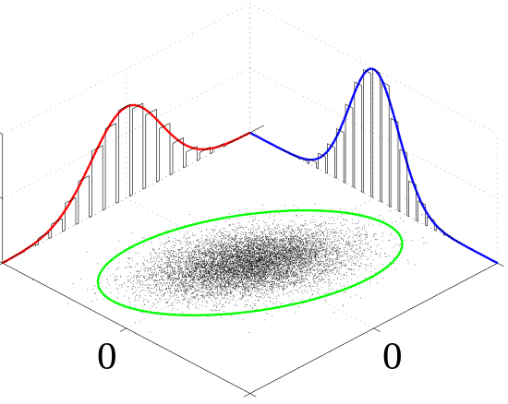
Recall: Multiple parameters: Marginalisation
Distributions are often NOT the function of 1 parameter
$$p(x,y)$$
NB: Coursework 1: is ‘happiness’ a function solely of GDP?
The probability of $x$ is calculated by integrating over $y$
$$p(x)=∫p(x,y)dy$$
NB: We wanted to measure $p(\text{happiness}|\text{GDP})$, but we measured $p(\text{happiness},\text{country}|\text{GDP})$
$p(\text{happiness}|\text{GDP})=p(\text{happiness},\text{UK}|\text{GDP})+p(\text{happiness},\text{France}|\text{GDP})+p(\text{happiness},\text{Spain}|\text{GDP})+...$

Slide 26
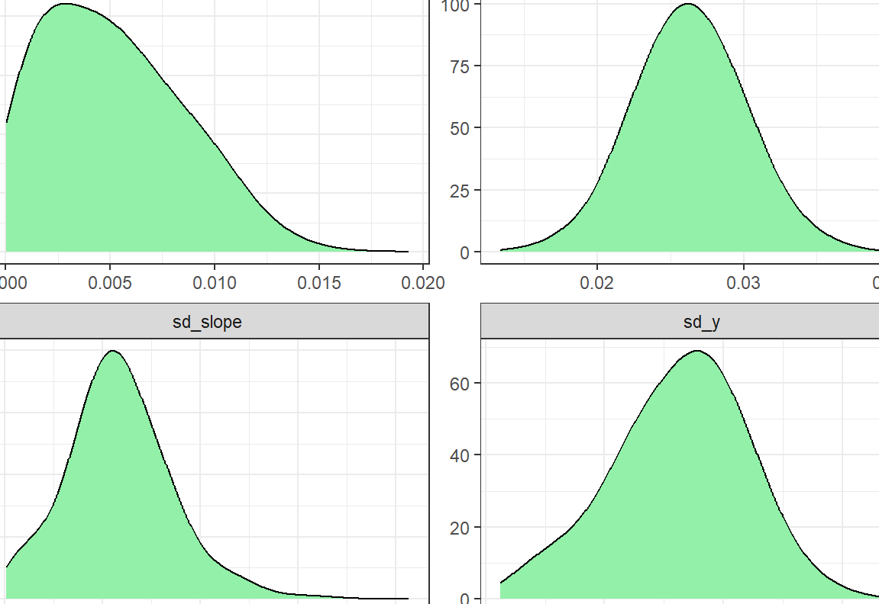
Bayes Theorem : In practice
Physics is complex: priors and likelihoods are rarely analytic and routinely complicated
Multiple peaks is often common
Notes:
1760s

Slide 27
Bayes Theorem : Sampling
grid_like = []
for s in scale:
for o in offset:
like_val = chi2(data, model(*(x,y))
grid_like.append(like_val)
…
plt.contour(scale, offset, grid_like)
Very slow and very inefficient
Requires starting point
Notes:
1760s

Slide 28
Markov Chain Monte Carlo Sampling
Monte Carlo:
Computer simulation where we generate many realisations of the data
Either from the data (e.g. uncertainties) or the model
> from numpy import random
Markov chain:
Sequence of events : each outcome determines what happens next
No prior memory; only the current step is relevant
MCMC:
Stochastic process to explore a parameter space
Sampler of the posterior: $p(θ|D)∝p(D|θ)p(θ)$
Many different mathematically motivated examples
Notes:
1760s

Slide 29
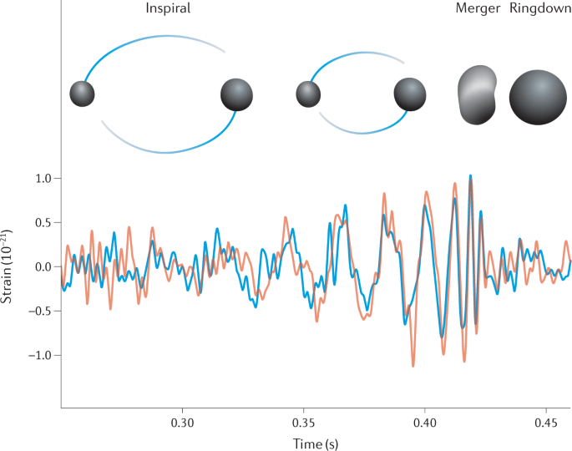
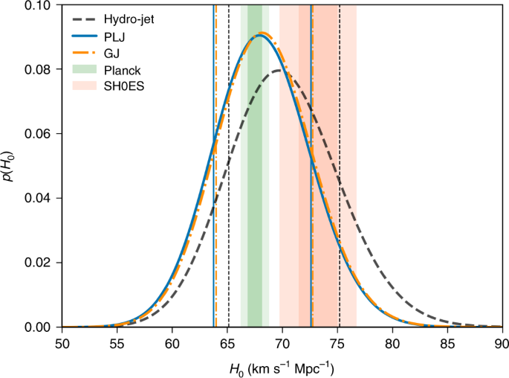
Markov Chain Monte Carlo Sampling
Very common across physics
Notes:
1760s

Slide 30
Metropolis-Hastings Algorithm
Consider a distribution $P(θ)$
Make an initial guess for the variables ($θ_{\text{current}}$)
Propose a random step to a new location ($θ_{\text{proposed}}=θ_{\text{current}}+Δθ$):
Calculate the probability of both points ($p(θ_{\text{current}}),p(θ_{\text{proposed}})$)
If $p(θ_{\text{proposed}})>p(θ_{\text{current}})$ then accept $θ_{\text{proposed}}$
If $p(θ_{\text{proposed}})<p(θ_{\text{current}})$ then:
Draw a uniform random number, $u$, between [0,1]
If $u≤\frac{p(θ_{\text{proposed}})}{p(θ_{\text{current}})}$ then accept $θ_{\text{proposed}}$
else: then stay at $θ_{\text{current}}$
Notes:
1760s

Slide 31
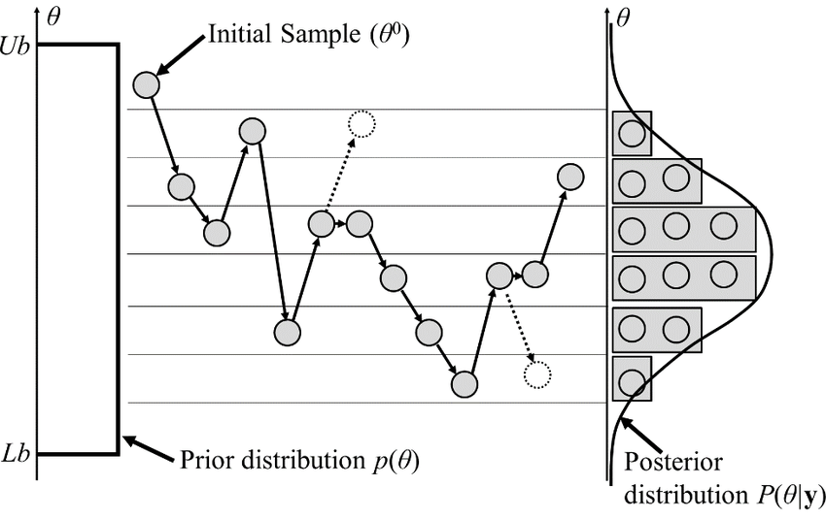
Metropolis-Hastings Algorithm
Consider a distribution $P(θ)$
Notes:
1760s

Slide 32
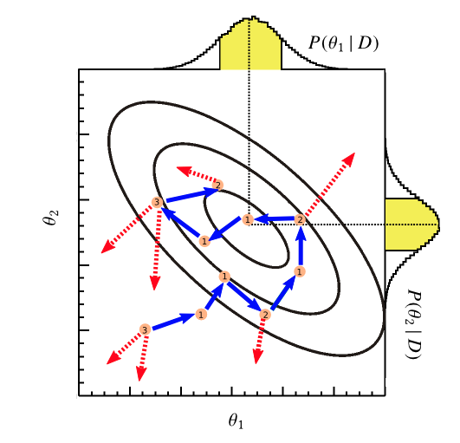
Metropolis-Hastings Algorithm
Consider a 2D distribution $P(θ)$
Notes:
1760s

Slide 33
Metropolis-Hastings Algorithm
Key features:
no need to know the true normalised probabilities
$$p_{\text{move}}=\frac{p(θ_{\text{proposed}})}{p(θ_{\text{current}})}$$
only requirement is that $p>0$
no memory of previous steps
Generate a random value
Evaluate $p(θ_{\text{proposed}})$
Draw a random uniform value
Repeat N times
Simple to implement:
Notes:
1760s

Slide 34
Metropolis-Hastings Algorithm
Common problems:
starting value far from $L_{\text{max}}$
Reject the first N steps : the burn in
suitable values for $Δθ$
Trial & error
Small value == slow exploration
Large value == low acceptance rate
local maxima
multiple peaks in the distribution
Notes:
1760s

Slide 35
Metropolis-Hastings Algorithm
Advantages:
easy to code
plenty of pre-made packages available
easy to test
fine-tuning is possible with modern computers
mathematically rigorous
always works as $n_{\text{samples}}→∞$
Notes:
1760s

Slide 36
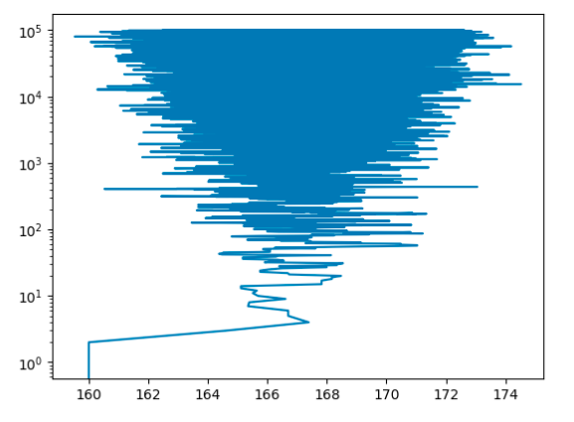
Convergence: look at the data
many mathematical
approaches available
# iterations
burn-in
parameter value
Calculate mean, $σ$ at regular intervals ; calculate acceptance rate (~0.4)
Perform and combine multiple chains from different initial conditions
Notes:
1760s

Slide 37
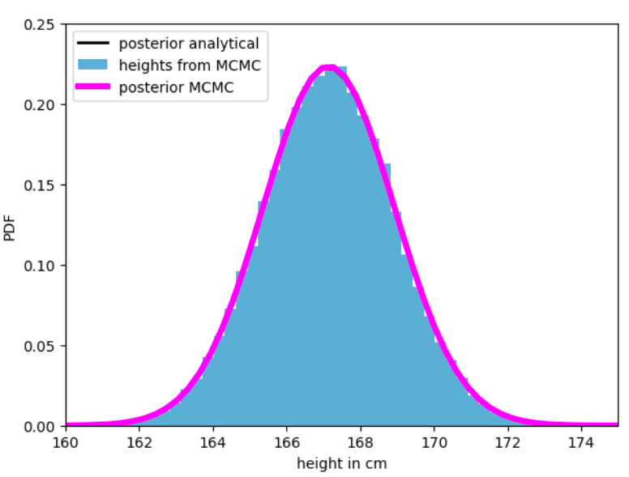
Finding the posterior: marginalisation
The cool part: A histogram of the chain is the marginalisation!
Notes:
1760s

Slide 38
Notes:
1760s

Slide 39
Markov-Chain Monte-Carlo
Alternatives:
Gibbs Sampling :
https://en.wikipedia.org/wiki/Gibbs_sampling
Nested Sampling :
https://en.wikipedia.org/wiki/Nested_sampling_algorithm
Hierarchical Regression :
https://en.wikipedia.org/wiki/Multilevel_model
Hamiltonian Monte Carlo (inc NUTS):
https://en.wikipedia.org/wiki/Hamiltonian_Monte_Carlo
Notes:
1760s

Slide 40
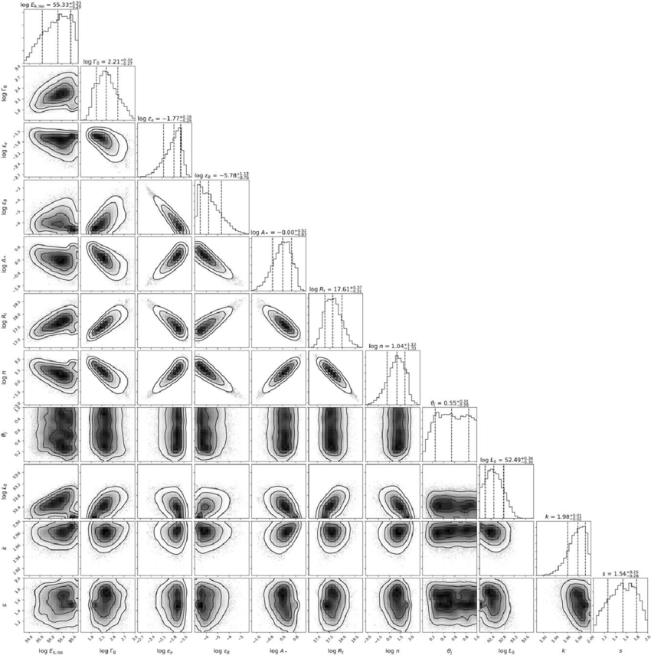
Output:
multiple degenerate parameters
complicated distributions
=> all constrained simultaneously
Notes:
1760s

Slide 41
Week 13: Learning outcomes
Today we have learnt
The mathematical formalism for Bayes theorem
The difference between the posterior, likelihood, prior and evidence
The fundamental difference between Bayesian v Frequentist
How to sample a/multiple parameters efficiently
Markov Chain Monte Carlo (MCMC)
The Metropolis-Hastings algorithm
How to implement this in python
Practical examples on Friday!

